Slide 1
Intermediate programming
Session 06
ICT40220 Certificate IV in Information Technology (Programming)
Cluster: Intermediate programming and open source (IPOS)
ICTPRG439 | Use pre-existing components
ICTPRG429 | Maintain open-source code programs
ICTPRG443 | Apply intermediate programming skills in different languages

Slide 2
Debugging and documentation
Session 06 - Week 07

Slide 3
Overview
Debugging
Key python debuggers
Debugging versus logging
Documentation
Python documentation
Doctests
Generating documentation

Slide 4

debugging

Slide 5
de bugging

Slide 6
aka. removing bugs
de bugging
aka. programming

Slide 7
de bugging
aka. removing bugs
aka. programming
aka. programming

Slide 8
de bugging
aka. removing bugs
aka. programming
aka. programming

Slide 9
Working with Bugs
Understand the Problem
Write & Run Unit Tests
Isolate the Problem for the wider application
Use a variety of Debugging Tools
Correct the bug
Verify the Stability of the Fix
Document the Solution

Slide 10

Hot take
The humble print statement is also a debugger
No lesser than Guido van Rossum himself has been quoted as saying that he uses print statements for 90% of his debugging.
Notes:
Link: https://lemire.me/blog/2016/06/21/i-do-not-use-a-debugger/#:~:text=The%20author%20of%20Python%2C%20Guido,for%2090%25%20of%20his%20debugging.
You don’t need to use a debugger to be a good programmer – but you do need to know how one is used.
How useful it will be for you, how often you will reach for it, will depend on you: how your mind works and the kind of programming you do. Don’t feel you have to use a debugger if you are doing just fine debugging without one.

Slide 11
Python debugging tools
Tool | Description | Pros | Cons
Print Statements | display variable values or flow. | No setup required | Manual Clutters code Not efficient for complex issues
pdb (Python Debugger) | Built-in interactive cli tool | inspect variables and control execution, directly on the server | CLI based, steep learning curve
python -i | Starts the Python interpreter after script execution. | immediate interaction with final state of script variables | only useful for post-execution state
IDE-based Tools (e.g., PyCharm) | Integrated tools in an IDE designed for debugging. | advanced features like conditional breakpoints | requires configuration
Notes:
-Generated by ChatGPT4

Slide 12
Debugger workflow
Set a breakpoint: where do you want execution to pause
Manually step through the code using the debugger (proceed to the next line after the breakpoint when you are ready)
Inspect local variables, global variables, and the call stack
Run arbitrary statements within the execution context

Slide 13
Debugger specific
Concept | Brief Overview | PDB Command | PyCharm Debugger (Keyboard Shortcut)
Step Over | Execute the current line of code and stop at the next | n or next | F8
Step Into | Delve into the function or method being called | s or step | F7
Step Out | Finish the current function and stop at the caller | r or return | Shift + F8
Move Up | Go up in the call stack | (pdb) up | Alt + Shift + Up Arrow
Move Down | Go down in the call stack | (pdb) down | Alt + Shift + Down Arrow

Slide 14
Debugger specific steps (cont.)
Concept | Brief Overview | PDB Command | PyCharm Debugger (Keyboard Shortcut)
Access Variables | View the value of local variables | p variable_name | Alt + F8 (Evaluate Expression)
Continue | Resume program execution until the next breakpoint | c or continue | F9
Set Breakpoint | Halt program execution at a specific line | b line_num | Ctrl + F8
List Code | Display source code around the current line | l or list | N/A (PyCharm shows source by default)

Slide 15
Other key tasks
Action | Description | PDB | PyCharm Debugger
Set Breakpoint | Halt execution at a specific line | breakpoint() | Ctrl + F8 (Click on gutter)
Set Conditional Breakpoint | Halt execution only if a condition is met | breakpoint() within an if clause | Right-click on breakpoint, select 'Edit' and set condition
Break on Exception | Pause execution when a specific exception is raised | breakpoint() inside an except clause | In the Breakpoints dialog (Ctrl + Shift + F8), enable the specific exception
View Active Breakpoints | List all the breakpoints | pdb command: break | Ctrl + Shift + F8 (Opens Breakpoints dialog)
Delete a Breakpoint | Remove set breakpoint | pdb commands: cl or clear | Right-click on breakpoint and choose 'Remove'
Enable/Disable Breakpoint | Toggle breakpoint without removing it | pdb commands: disable or enable | Right-click on breakpoint and select 'Disable/Enable'
↓↓

Slide 16

Use __repr__ with your own classes to make debugging easier.** The 'default' repr is not very helpful (e.g. <__main__.MyClass object at 0x7f9b8c0b6a90>).
Notes:
** Caveat: PyCharm has an annoying bug in its debugger (ha!) that it shows the __str__ instead of the __repr__ though it may have recently (mid 2023, open since 2016) been fixed. See: https://youtrack.jetbrains.com/issue/PY-35529 Why it matters: https://realpython.com/python-repr-vs-str/

Slide 17
Limits of debugging
Not all issues are immediately reproducible.
Debugging does not provide insights into the program's performance in different environments.

Slide 18
Enter logging
Logging: Systematic recording of events in an application.
When Logging is more suitable:
Monitoring software in real-world environments.
Tracing issues that are sporadic or environment-specific.
Reproducing a “sequence” of events in a multithreaded context*
Analysing problems post-occurrence.
When Debugging is more suitable:
Addressing and understanding errors during development.
Getting real-time insights into code behaviour and state.

Slide 19
Activity 1
Notes:
Review the in class code examples before taking on Activity 1

Slide 20
Documenting CODE
Part 2

Slide 21
Conceptual
Documentation as code
docstrings within functions, classes, and modules are a good example of "Documentation as Code."
automatically compiled into documentation using tools like Sphinx or MkDocs.

Slide 22
Conceptual
Multi-modal documentation
Traditional text-based documentation
Software like Jupyter notebooks showing how to use the code interactively.
Flowcharts illustrating the architecture

Slide 23
Conceptual
Fit with Automation - CI & CD
Tools and service with build and automatically quality check our documentation before/after deployment

Slide 24
Python documentation
A multi-line string in key positions is a docstring
Module, class, and function/method docstring
Automagically populates help(), IDE tips
Stored in __doc__ variable
Can include doctests
Leveraged by pydoc

Slide 25
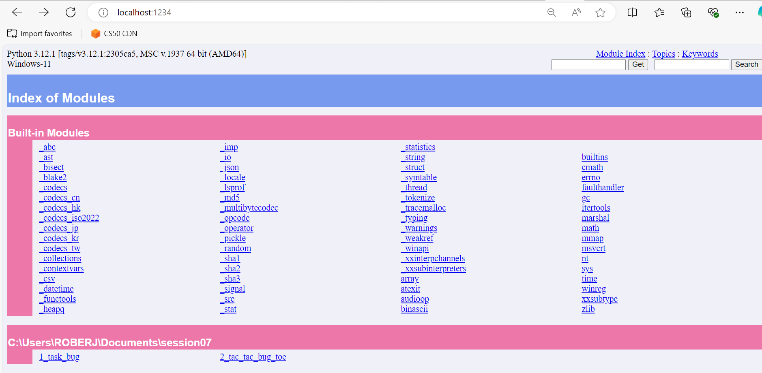
Pydoc
# Run this in your terminal
pip install pydoc
python -m pydoc -p 1234
Notice that the help() function is used to produce docs for your installed python versions
Notes:
❯ python -m pydoc --help
pydoc - the Python documentation tool
pydoc <name> ...
Show text documentation on something. <name> may be the name of a
Python keyword, topic, function, module, or package, or a dotted
reference to a class or function within a module or module in a
package. If <name> contains a '/', it is used as the path to a
Python source file to document. If name is 'keywords', 'topics',
or 'modules', a listing of these things is displayed.
pydoc -k <keyword>
Search for a keyword in the synopsis lines of all available modules.
pydoc -n <hostname>
Start an HTTP server with the given hostname (default: localhost).
pydoc -p <port>
Start an HTTP server on the given port on the local machine. Port
number 0 can be used to get an arbitrary unused port.
pydoc -b
Start an HTTP server on an arbitrary unused port and open a web browser
to interactively browse documentation. This option can be used in
combination with -n and/or -p.
pydoc -w <name> ...
Write out the HTML documentation for a module to a file in the current
directory. If <name> contains a '/', it is treated as a filename; if
it names a directory, documentation is written for all the contents.

Slide 26
Pydoc Commands
❯ python -m pydoc --help
pydoc - the Python documentation tool
pydoc <name> ...
Show text documentation on something.
pydoc -k <keyword>
Search for a keyword in the synopsis lines of all available modules.
pydoc -n <hostname>
Start an HTTP server with the given hostname (default: localhost).
pydoc -p <port>
Start an HTTP server on the given port on the local machine. Port
number 0 can be used to get an arbitrary unused port.
pydoc -b
Start an HTTP server on an arbitrary unused port and open a web browser
to interactively browse documentation.
pydoc -w <name> ...
Write out the HTML documentation for a module to a file in the current
directory.
Notes:
❯ python -m pydoc --help
pydoc - the Python documentation tool
pydoc <name> ...
Show text documentation on something. <name> may be the name of a
Python keyword, topic, function, module, or package, or a dotted
reference to a class or function within a module or module in a
package. If <name> contains a '/', it is used as the path to a
Python source file to document. If name is 'keywords', 'topics',
or 'modules', a listing of these things is displayed.
pydoc -k <keyword>
Search for a keyword in the synopsis lines of all available modules.
pydoc -n <hostname>
Start an HTTP server with the given hostname (default: localhost).
pydoc -p <port>
Start an HTTP server on the given port on the local machine. Port
number 0 can be used to get an arbitrary unused port.
pydoc -b
Start an HTTP server on an arbitrary unused port and open a web browser
to interactively browse documentation. This option can be used in
combination with -n and/or -p.
pydoc -w <name> ...
Write out the HTML documentation for a module to a file in the current
directory. If <name> contains a '/', it is treated as a filename; if
it names a directory, documentation is written for all the contents.

Slide 27
Documentation standards
Google
Numpy
Sphinx
Notes:
Review docuemntation.py

Slide 28
Documentation
Internal vs External

Slide 29
Documentation – Internal You will provide this…
understand the purpose of various components within the codebase.
identifies dependencies between different components &
the impact of changes on the overall system (version & MVP)
guidance on structure, conventions, and best practices
API parameters, return values, exceptions including usage examples for modules, classes & methods
test cases designed on documented specifications

Slide 30
Documentation – External Lecturer will provide this…
guide on how to install, configure, and use the application.
external consumption of functions, classes, return value and examples
included tutorials and examples
release notes with new features, enhancements, bug fixes, and known issues.
guidelines and instructions covering coding standards, version control & code review processes (how to submit pull requests)

Slide 31

Sphinx??

Slide 32


Slide 33
project = 'Demo Doc'
copyright = '2023, Raf'
author = 'Raf'
release = '0.0.1'
# -- General configuration ---------------------------------------------------
# https://www.sphinx-doc.org/en/master/usage/configuration.html#general-configuration
extensions = ['sphinx.ext.autodoc',
'sphinx.ext.napoleon']
templates_path = ['_templates']
exclude_patterns = ['_build', 'Thumbs.db', '.DS_Store']
# -- Options for HTML output -------------------------------------------------
# https://www.sphinx-doc.org/en/master/usage/configuration.html#options-for-html-output
html_theme = 'sphinx_rtd_theme'
html_static_path = ['_static']
# Autodoc settings
autodoc_typehints = "description"
# Napoleon settings
napoleon_google_docstring = True

Slide 34
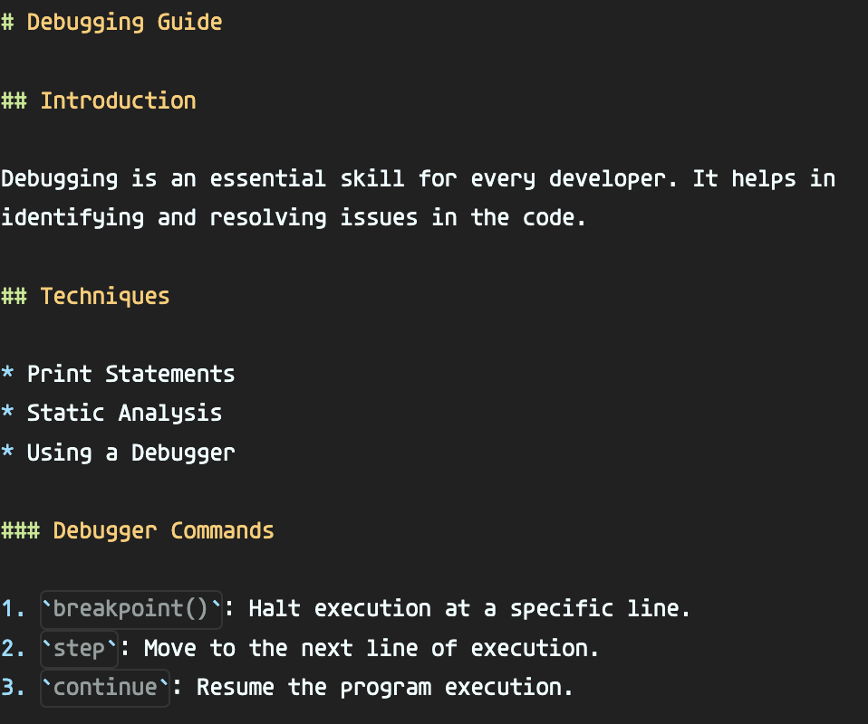
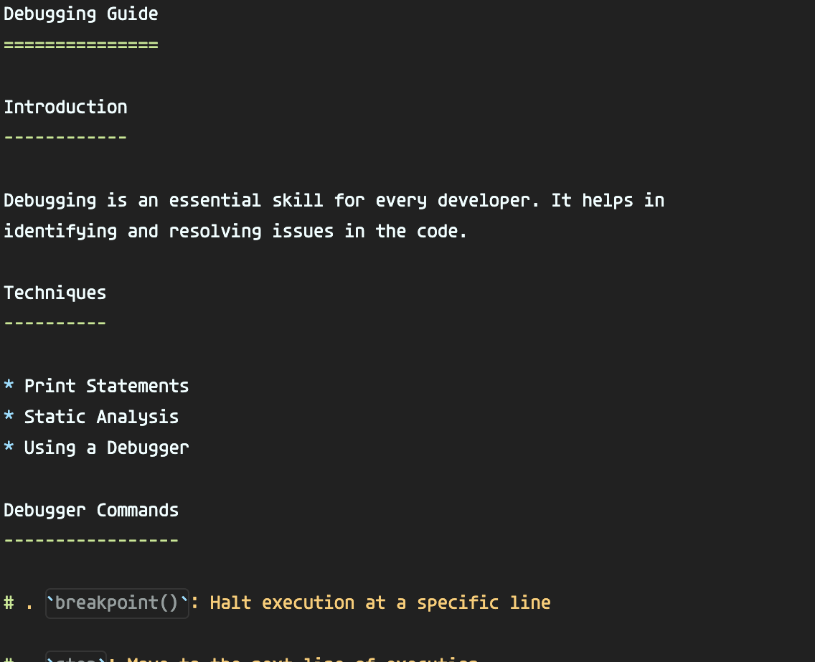
__reStructuredText (rst)__
** markdown (md) **
Notes:
Notes:
Review before activities
documentation in class code examples
completed Sphinx examples & code
Similarities Between Markdown and RST
Purpose: Both are lightweight markup languages designed to be easily read and written by humans. They are often used for documentation, readme files, and web content.
Headings: Both provide ways to denote hierarchical section headings.
Lists: Both support creating ordered (numbered) and unordered (bullet point) lists.
Code Blocks: Both allow for demarcating sections of code, though the methods differ.
Hyperlinks: Both allow for creating hyperlinks, though the syntax and capabilities vary.
Differences Between Markdown and RST
Syntax: While they share some similarities, the syntax for many elements in RST is more explicit. For instance, headings in RST are demarcated by repeated characters above and/or below the text, while Markdown uses a number of # characters at the start of the line.
Extensibility: RST was designed with extensibility in mind. It supports custom roles and directives, which allow users to define custom semantics and processing behaviours. Markdown, in its standard form, does not have this level of extensibility.
Footnotes & Citations: RST has built-in support for footnotes, citations, and even more complex structures like tables of content. Standard Markdown does not have native support for these, though some flavours'/extensions do.
Roles and Directives: Unique to RST, roles and directives are powerful extensibility mechanisms. Roles are used for semantic markup, and directives are block-level elements with arguments and content.
Target Audience: Markdown was originally developed for web writers. Its goal was simplicity and easy conversion to HTML. RST, on the other hand, was created for the Python documentation and provides richer features for technical documentation. MyST: The Bridge Between Markdown and RST
MyST stands for Markedly Structured Text. It is essentially an extension of the Markdown syntax to include some of the powerful features of reStructuredText (RST). MyST was created to provide a solution to a common problem: many people like Markdown's simplicity but often need the extensibility and features of RST.
Key Features:
RST-like Directives and Roles: MyST allows the use of RST-like directives and roles directly in Markdown documents. This means you can use functionalities like tables of contents, figures, notes, and more in a Markdown file.
Extensibility: Similar to RST, you can also define custom roles and directives in MyST.
Math Support: With MyST, you can use LaTeX-like math syntax which will be familiar to many academic and scientific writers.
Footnotes & Citations: Just like RST, MyST has robust support for footnotes and citations.
Compatible with Sphinx: One of the most significant advantages of MyST is its compatibility with Sphinx, a popular documentation generator. With the myst-parser Sphinx extension, you can write your entire Sphinx documentation in MyST-compatible Markdown, benefiting from the tooling and extensibility that Sphinx offers without delving into RST.
Why is MyST Important?
Wider Adoption: By combining the simplicity of Markdown with the power of RST, MyST has the potential to appeal to a broader audience, allowing more people to create rich documentation without the steep learning curve of RST.
Unified Ecosystem: Tools like Jupyter Book use MyST as their underlying markup language, enabling richer content in Jupyter notebooks and bridging the gap between the interactive computing and documentation worlds.

Slide 35
Activity 2

Slide 36
Activity 3

